Slide 1

ARTIFICIAL INTELLIGENCE
&
MACHINE LEARNING
SESSION NO : 21
Under/over fitting, bias-variance tradeoff, cross-validation, train/val/test splits, learning/validation curves.

Slide 2
Feature Selection & Model Selection – Part 2
In machine learning, creating a model that performs well is not just about choosing a good algorithm.
It also depends on selecting the right features and validating the model properly.
In this session, we’ll explore how to avoid underfitting and overfitting, how to balance bias and variance, and how to split data and validate models effectively.

Slide 3
Underfitting and Overfitting
Underfitting happens when the model is too simple to capture the patterns in the data.
  Poor performance on both training and testing data.
  Common in linear models applied to complex data.
Overfitting happens when the model is too complex.
  It memorizes the training data, including noise and outliers.
  Performs well on training data but poorly on new, unseen data.
Our goal is to build a model that generalizes well – meaning it performs well on both known and unknown data.

Slide 4
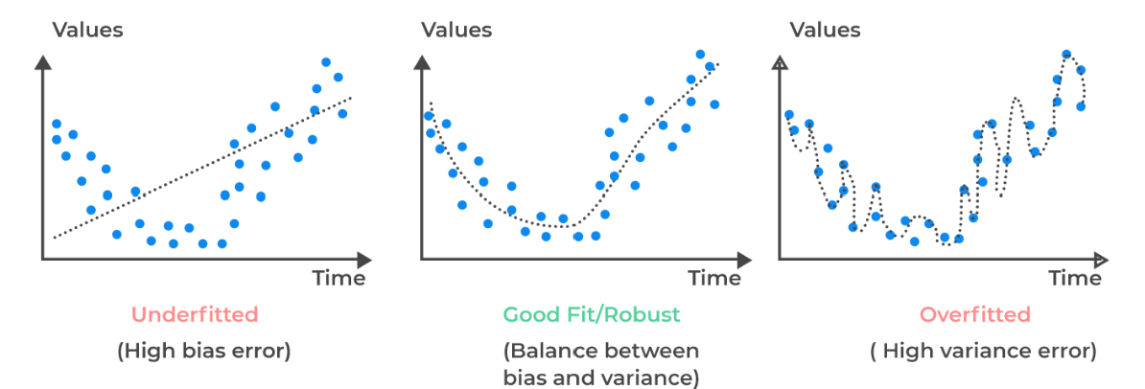
Underfitting and Overfitting

Slide 5
Bias-Variance Tradeoff
Bias is the error due to overly simple assumptions.
  High bias models ignore important trends → underfitting.
Variance is the error due to model sensitivity to small changes in the data.
  High variance models capture noise as if it were signal → overfitting.
Tradeoff: A complex model reduces bias but increases variance. A simple model reduces variance but increases bias.
Goal: Find the optimal point where both bias and variance are balanced to minimize total error.

Slide 6
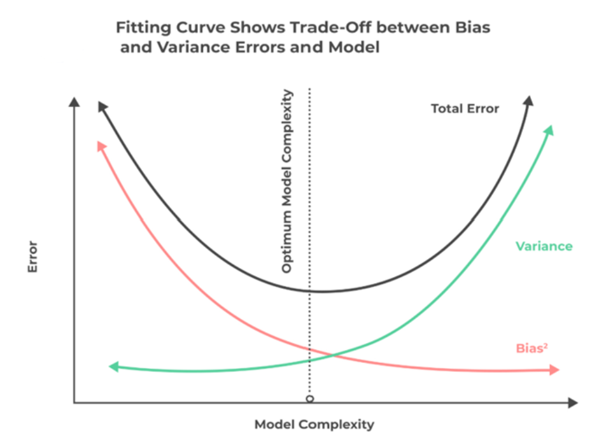
Bias-Variance Tradeoff

Slide 7
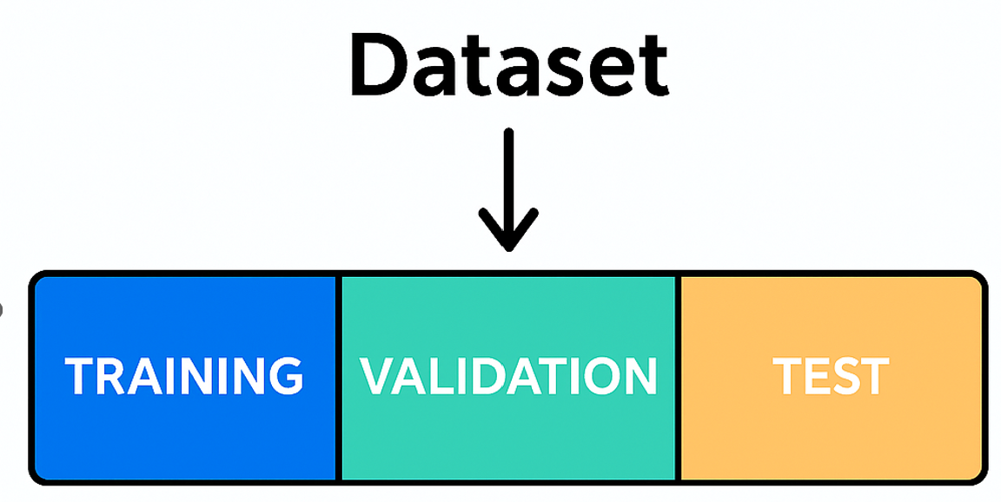
Train / Validation / Test Split
Training set: Used to teach the model.
Validation set: Used to tune hyperparameters and prevent overfitting.
Test set: Used to evaluate final model performance on unseen data.
Common ratios:
70% train, 15% validation, 15% test
60/20/20 for smaller datasets
Tip: Never test on data the model has already seen.

Slide 8
Cross-Validation
Cross-validation is a technique used to make better use of limited data and ensure model stability.
K-Fold Cross-Validation:
Divide data into k parts (folds).
Train the model k times, each time using a different fold as the validation set.
Average the results.
Benefits:
Reduces the impact of a bad data split.
More accurate performance estimation.

Slide 9
Learning Curves
Learning curves show how model performance changes with more training data.
Training curve: Error on training data
Validation curve: Error on validation data
What curves tell us:
High bias: Both errors are high → add complexity
High variance: Big gap between training and validation errors → reduce complexity
Good fit: Curves converge at low error
Use learning curves to guide model tuning.

Slide 10
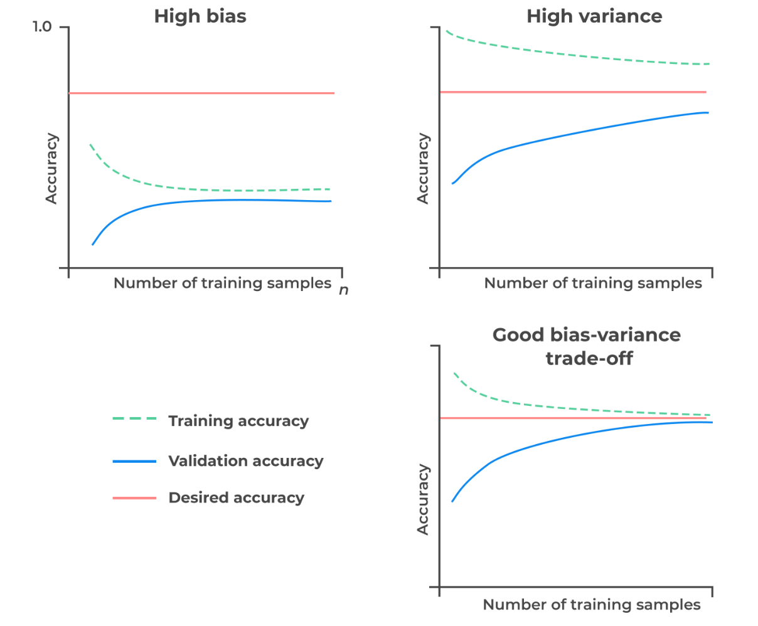
Learning Curves

Slide 11
Validation Curves
Show how performance varies with changes in model parameters (like depth of tree, number of neighbors, etc.)
Helps find the best hyperparameter to prevent underfitting or overfitting.
Example:
Try different values for a regularization parameter and track validation accuracy to find the sweet spot.

Slide 12
Student Marks Prediction Project
Inputs: Study hours, Attendance, Mid-term marks, Assignments.
Models: Linear Regression, Decision Tree, Random Forest.
Steps:
1. Split dataset into train/val/test.
2. Use cross-validation.
3. Plot learning curve.
4. Use validation curve to tune.
5. Avoid overfitting with pruning.
6. Test on unseen data only.

Slide 13
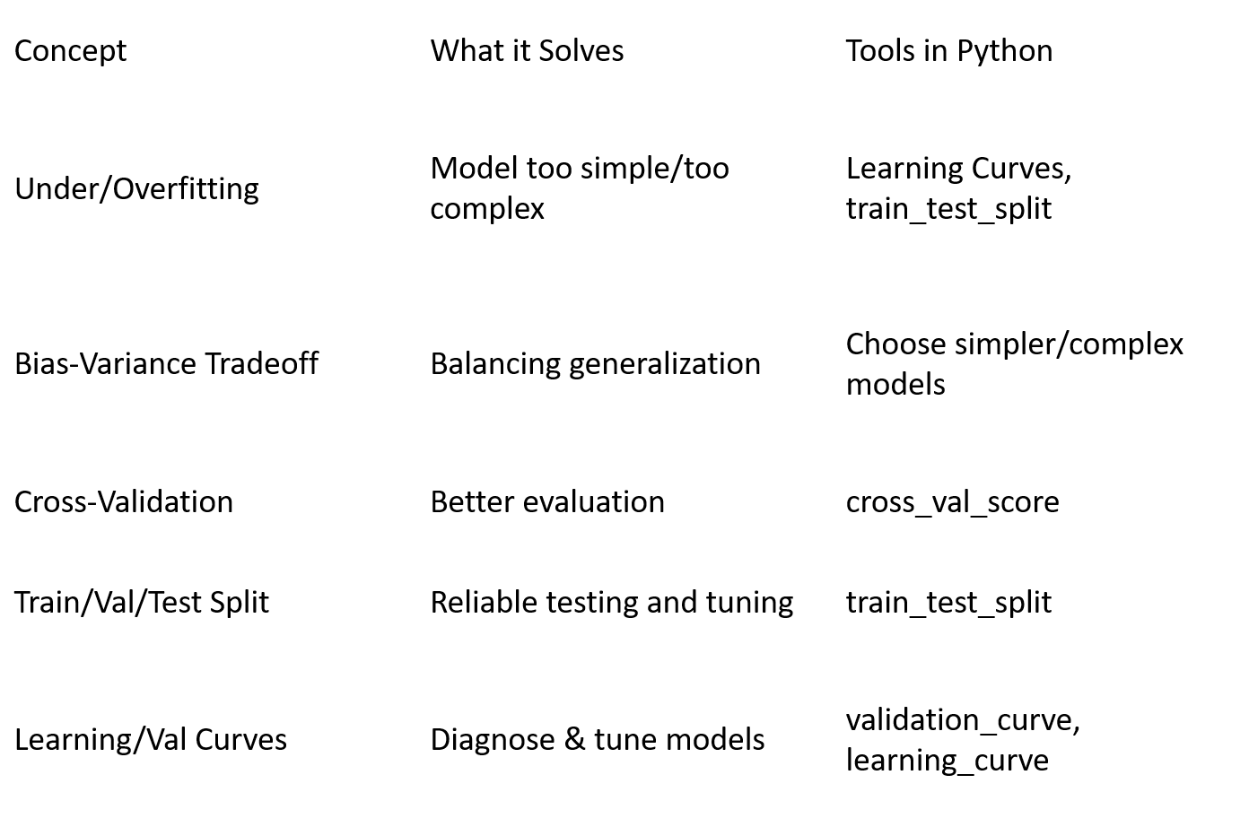
Summary Table

Slide 14
Project Description
- Predict final exam scores based on:
- • Study hours
- • Attendance
- • Midterm marks
- • Assignments
Model: Linear Regression
Evaluation: Under/Overfitting, Bias-Variance, CV, Learning/Validation Curves

Slide 15
Student Marks Prediction Project
Feature Selection & Model Selection Concepts with Graphs and Explanations

Slide 16
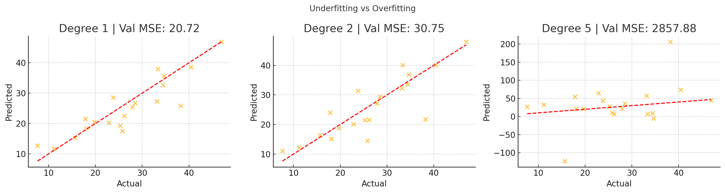

Underfitting vs Overfitting
Degree 1: Too simple (underfit), Degree 2: Balanced fit, Degree 5: Too complex (overfit).

Slide 17
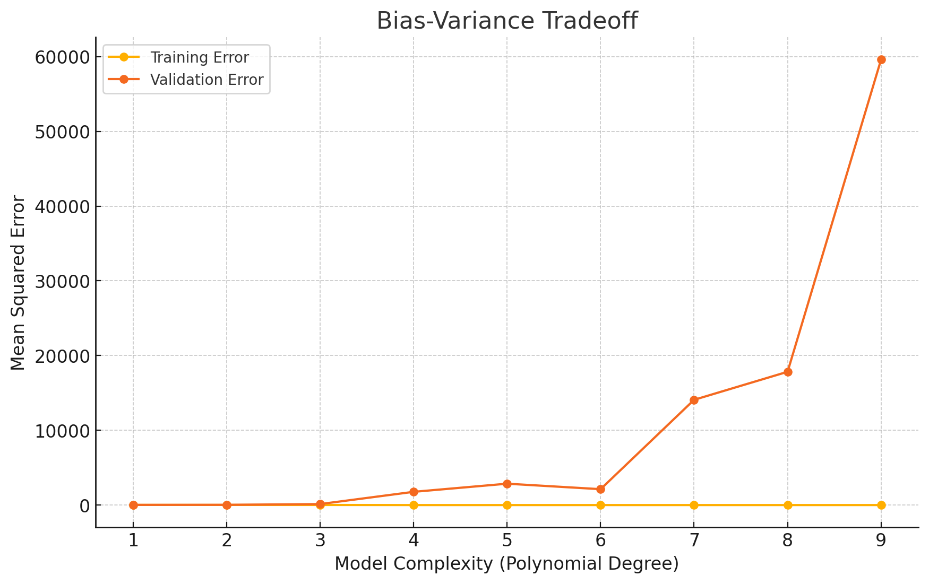
Bias-Variance Tradeoff
Low-degree models underfit (high bias); high-degree models overfit (high variance).

Slide 18
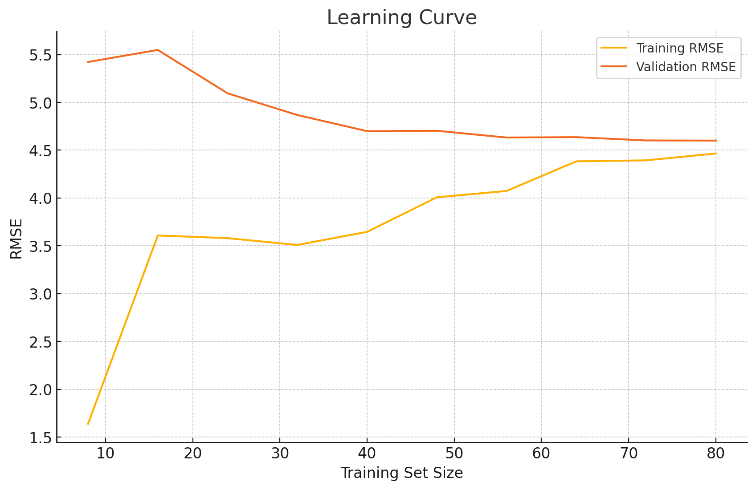
Learning Curve
Shows model improvement with more data. Validation RMSE decreases with more training samples.

Slide 19
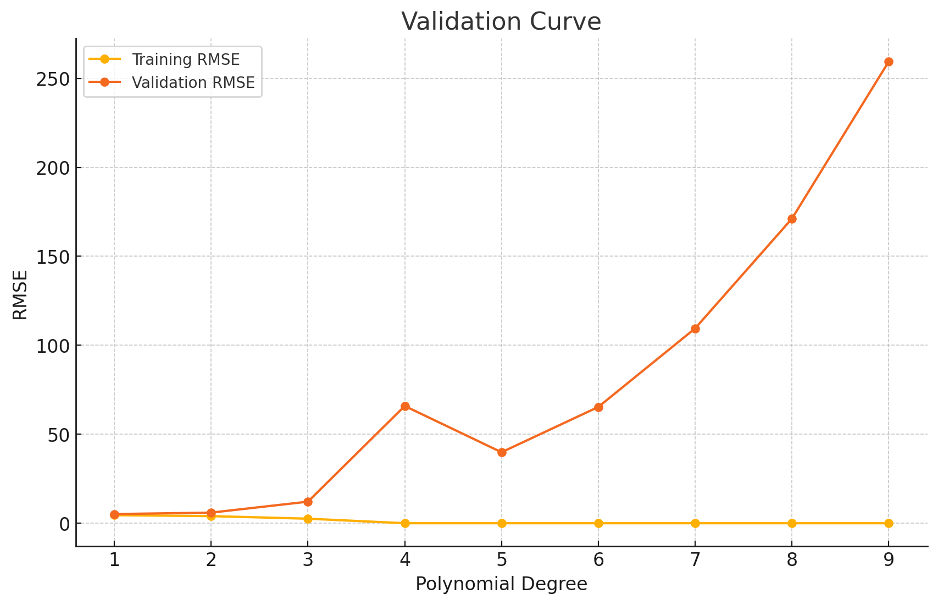
Validation Curve
Validation RMSE vs polynomial degree. Helps find optimal model complexity.

Slide 20
Conclusion / Key Takeaways
Avoid underfitting by choosing a model that’s expressive enough.
Avoid overfitting using regularization, simpler models, and validation techniques.
Split your data properly and use cross-validation to evaluate reliability.
Use learning and validation curves to guide decisions.
*Remember: A good model doesn’t just memorize, it learns patterns that generalize!

